Slide 1

Defining Variable Types
Chris Piech
CS106A, Stanford University

Slide 2
Can you do this?

Slide 3
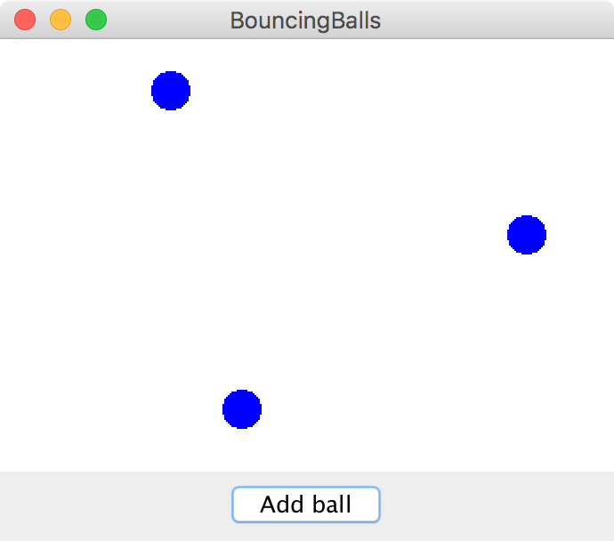
Bouncing Balls

Slide 4
Interactors

Slide 5
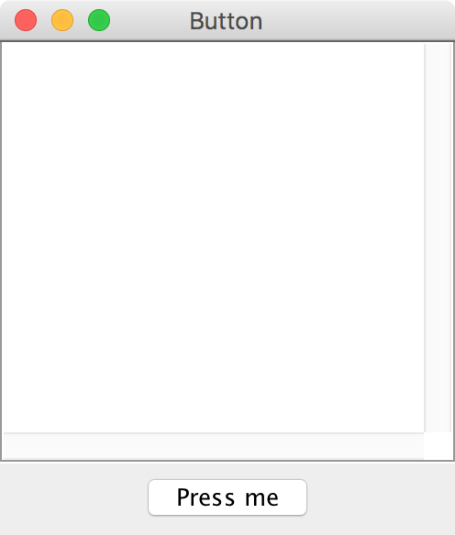
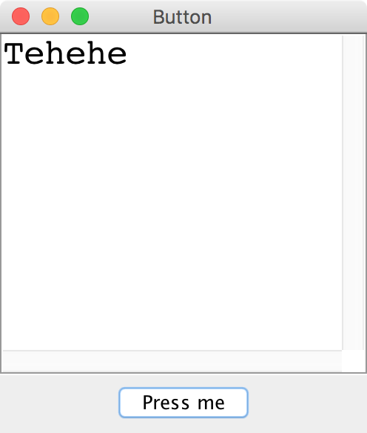
Button

Slide 6
JButton

Slide 7
JButton
JButton button = new JButton("Press me");

Slide 8
JButton
Button Text
JButton button = new JButton("Press me");

Slide 9

JButton
JButton button = new JButton("Press me");
add(button, SOUTH);

Slide 10
JButton
JButton button = new JButton("Press me");
add(button, SOUTH);
addActionListeners();

Slide 11
JButton
public void actionPerformed(ActionEvent e) {
String actionCmd = e.getActionCommand();
if(actionCmd.equals(“Press me”)) {
println(“Tehehe”);
}
}

Slide 12
JButton
public void actionPerformed(ActionEvent e) {
String actionCmd = e.getActionCommand();
if(actionCmd.equals(“Press me”)) {
println(“Tehehe”);
}
}

Slide 13
JButton
public void actionPerformed(ActionEvent e) {
String actionCmd = e.getActionCommand();
if(actionCmd.equals(“Press me”)) {
println(“Tehehe”);
}
}

Slide 14
JButton
public void actionPerformed(ActionEvent e) {
String actionCmd = e.getActionCommand();
if(actionCmd.equals(“Press me”)) {
println(“Tehehe”);
}
}

Slide 15
End review

Slide 16
Some large programs are in Java

Slide 19
How?

Slide 20

Define New Variable Types
Email Sender
Login Manager
Inbox Database
Email
Inbox
User

Slide 21
Even small programs
define new variable types

Slide 22
You Have Been Using Variable Types
GOval
String
“Hello, world”
RandomGenerator
What would it take to define your own?

Slide 23


Classes define new Variable Types
A student registration system needs to store info about students, but Java has no Student type.
A music synthesizer app might want to store information about different voices, but Java has no Instrument type.
However, Java does provide a feature for us to add new data types to the language: classes.
Writing a class defines a new data type.
“This class is so meta” – Anonymous Stanford Student

Slide 24

Classes are like blueprints
class: A template for a new type of variable.
Blueprint for student
A blueprint is a helpful analogy

Slide 25
Classes define new variable types

Slide 26
Classes decompose your program across files

Slide 27
Classes are like blueprints
To design a new variable type you must specify three things:
What subvariables make up this new variable type?
What methods can you call on a variable of this type?
What happens when you make a new instance of this type?

Slide 28
What is a class?

Slide 29
A class defines a new variable type

Slide 30
Kenya has used mobile banking for > 10 years

Slide 31
Classes: Take 1
This goes in BankAccount.java!
public class BankAccount {
// the instance variable define what makes up the class
public String name;
public double money;
}
Instance variables have a special meaning

Slide 32
Classes: Take 1
public class BankAccount {
// the instance variable define what makes up the class
public String name;
public double money;
}
BankAccount.java
public class Benmo{
public void run() {
BankAccount chris = new BankAccount();
BankAccount mehran = new BankAccount();
chris.name = “Chris”;
chris.money = 100;
mehran.name = “Mehran”;
mehran.money = 999999;
}
}
Benmo.java

Slide 33
Classes: Take 1
public class BankAccount {
// the instance variable define what makes up the class
public String name;
public double money;
}
BankAccount.java
public class Benmo{
public void run() {
BankAccount chris = new BankAccount();
BankAccount mehran = new BankAccount();
chris.name = “Chris”;
chris.money = 100;
mehran.name = “Mehran”;
mehran.money = 999999;
}
}
Benmo.java
run
name
chris
money
mehran

Slide 34
Classes: Take 1
public class BankAccount {
// the instance variable define what makes up the class
public String name;
public double money;
}
BankAccount.java
public class Benmo{
public void run() {
BankAccount chris = new BankAccount();
BankAccount mehran = new BankAccount();
chris.name = “Chris”;
chris.money = 100;
mehran.name = "Mehran";
mehran.money = 999999;
}
}
Benmo.java
run
name
chris
money
name
mehran
money

Slide 35
Classes: Take 1
public class BankAccount {
// the instance variable define what makes up the class
public String name;
public double money;
}
BankAccount.java
public class Benmo{
public void run() {
BankAccount chris = new BankAccount();
BankAccount mehran = new BankAccount();
chris.name = “Chris”;
chris.money = 100;
mehran.name = "Mehran";
mehran.money = 999999;
}
}
Benmo.java
run
name
“Chris”
chris
money
name
mehran
money

Slide 36
Classes: Take 1
public class BankAccount {
// the instance variable define what makes up the class
public String name;
public double money;
}
BankAccount.java
public class Benmo{
public void run() {
BankAccount chris = new BankAccount();
BankAccount mehran = new BankAccount();
chris.name = “Chris”;
chris.money = 100;
mehran.name = "Mehran";
mehran.money = 999999;
}
}
Benmo.java
run
name
“Chris”
chris
money
100.0
name
mehran
money

Slide 37
Classes: Take 1
public class BankAccount {
// the instance variable define what makes up the class
public String name;
public double money;
}
BankAccount.java
public class Benmo{
public void run() {
BankAccount chris = new BankAccount();
BankAccount mehran = new BankAccount();
chris.name = “Chris”;
chris.money = 100;
mehran.name = "Mehran";
mehran.money = 999999;
}
}
Benmo.java
run
name
“Chris”
chris
money
100.0
name
"Mehran"
mehran
money

Slide 38
Classes: Take 1
public class BankAccount {
// the instance variable define what makes up the class
public String name;
public double money;
}
BankAccount.java
public class Benmo{
public void run() {
BankAccount chris = new BankAccount();
BankAccount mehran = new BankAccount();
chris.name = “Chris”;
chris.money = 100;
mehran.name = "Mehran";
mehran.money = 999999;
}
}
Benmo.java
run
name
“Chris”
chris
money
100.0
name
"Mehran"
mehran
money
999999.0

Slide 40
What is a class?

Slide 41
A class defines a new variable type

Slide 42
withdraw
Bank account data
run
deposit
Wall of abstraction

Slide 43
Adding Privacy
private double money;
encapsulation: Hiding implementation details of an object from its clients.
Encapsulation provides abstraction.
separates external view (behavior) from internal view (state)
Encapsulation protects the integrity of an object's data.
A class's instance variables should be declared private.
No code outside the class can access or change it.

Slide 44
Classes: Take 2
This goes in its own file!
public class BankAccount {
// the instance variable define what makes up the class
public String name;
public double money;
}
Instance variables have a special meaning

Slide 45
Classes: Take 2
public class BankAccount {
// 1. What variables make up the class
public String name;
public double money;
}

Slide 46
Classes: Take 2
public class BankAccount {
// 1. What variables make up the class
private String name;
private double money;
}

Slide 47
Classes: Take 2
public class BankAccount {
// 1. What variables make up the class
private String name;
private double money;
// 2. What methods can a user call on a bankAccount?
public void deposit(double amount) {
...
}
public boolean withdraw(double amount) {
...
}
}

Slide 48
Classes: Take 2
public class BankAccount {
// 1. What variables make up the class
private String name;
private double money;
// 2. What methods can a user call on a bankAccount?
public void deposit(double amount) {
money += amount;
}
public boolean withdraw(double amount) {
...
}
}

Slide 49
Classes: Take 2
public class BankAccount {
// 1. What variables make up the class
private String name;
private double money;
// 2. What methods can a user call on a bankAccount?
public void deposit(double amount) {
this.money += amount;
}
public boolean withdraw(double amount) {
...
}
}

Slide 50
this

Slide 51
Classes: Take 2
public class BankAccount {
// 1. What variables make up the class
private String name;
private double money;
// 2. What methods can a user call on a bankAccount?
public void deposit(double amount) {
this.money += amount;
}
public boolean withdraw(double amount) {
...
}
}

Slide 52
Classes: Take 2
public class BankAccount {
// 1. What variables make up the class
private String name;
private double money;
// 2. What methods can a user call on a bankAccount?
public void deposit(double amount) {
this.money += amount;
}
public boolean withdraw(double amount) {
if(amount <= this.money) {
this.money -= amount;
return true;
}
return false;
}
}

Slide 53
Classes: Take 2
public class BankAccount {
// 1. What variables make up the class
private String name;
private double money;
// 2. What methods can a user call on a bankAccount?
public void deposit(double amount) {
this.money += amount;
}
public boolean withdraw(double amount) {
if(amount <= this.money) {
this.money -= amount;
return true;
}
return false;
}
// 3. How do you make a new one?
public BankAccount(String name, double amount) {
this.money = amount;
this.money = name;
}
}

Slide 55
You must define three things
1. What variables does each instance store?
2. What methods can you call on an instance?
3. What happens when you make a new one?

Slide 56
Classes on one slide
1. What variables make up this new super variable type?
Instance variables
2. What methods can you call on a variable of this type?
It’s public methods
3. What happens when the user makes a new instance?
The “constructor”
* Don’t forget that all methods and constructors have access to a this reference

Slide 57
What is a class?

Slide 58
A class defines a new variable type

Slide 59
Bouncing Balls

Slide 60
A Ball Variable Type
The Ball class
1. What variables does each instance store?
Each ball has its own Goval (lets call it shape)
Each ball has its own dx
Each ball has its own dy
2. What methods can you call on an instance?
heartbeat();
getShape();
3. What happens when you make a new one?
Sets initial values for all the ”instance” vars
*details on how to define these three things coming soon

Slide 61
What classes?

Slide 62
What classes?

Slide 63
Good Work so Far

Slide 64
Good Work so Far
Using assignment timing as pre-post
Item Response Theory based ability assessment
7 hours
6.3 hours
Predicted time
Actual time
p < 0.00001
Score
ability
points
difficulty
Assignments are taking less time
Students perform better than expected

